Slide 1
Laughing for Learning
The Power of Humor in Education
Dan Griffith
National Sales Manager

Slide 2
Agenda
Understanding Humor
Research and Applications
Teaching Strategies
Summary/Closing Remarks

Slide 3
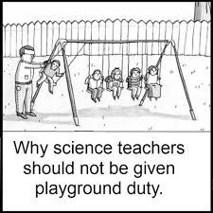
Laughing for Learning
Today, we look at humor in the classroom –
What makes things funny
Where is that all important “line”
How can we plan for humor
When can we integrate humor
Why is it important

Slide 4
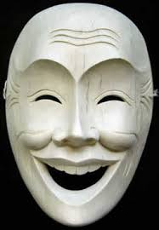
What is Funny?
Funny - providing fun; causing amusement or laughter; amusing; comical
Aristotle/Plato – Superiority theory
Laugh at the misfortune of others
Freud – Relief Theory
Laugh to relieve suppressed feelings
Modern – Incongruity Theory
- Laugh at things that are out of the norm or don’t fit correctly

Slide 5
Models
Peter McGraw at University of Colorado started the HuRL project (Humor Research Lab) and created the “Benign Violation Theory”.
Benign = doesn’t hurt anyone
Violation = incongruity
IMPORTANT – BOTH must be present for something to be funny
Analyze humorous situations
Create humorous opportunities
Define the “line” of appropriate humor

Slide 6
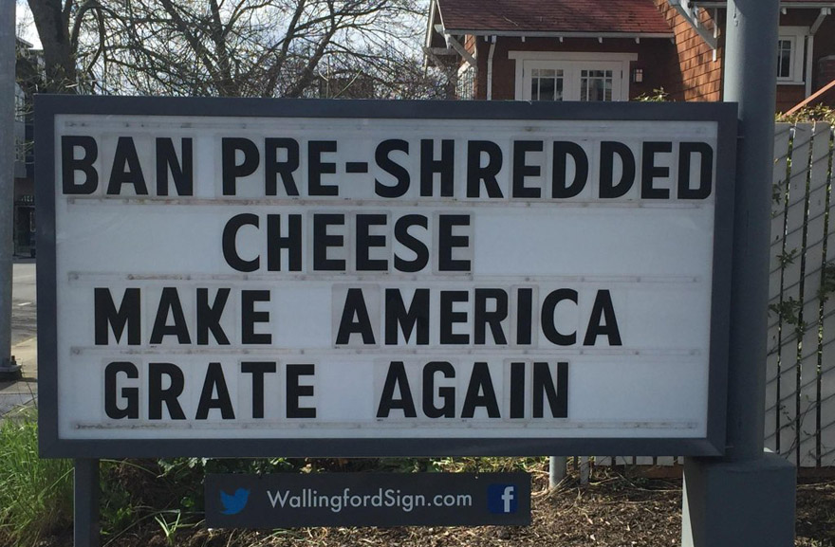
Examples
Father buys a lie detector that beeps whenever someone tells a lie.
Father: You were at school today, right?
Son: Yeah
Detector: BEEP
Son: OK, OK I went to John’s and we had a few beers.
Father: I would never have touched alcohol at your age.
Detector: BEEP
Mother: Ha, Ha, he really is your son!
Detector: BEEP

Slide 7
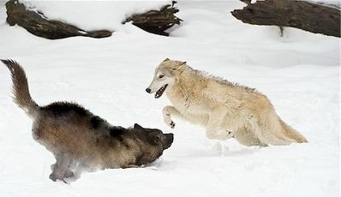
Humor Mimics Nature
Animals will “play” with different sounds and facial expressions to show that they are behind the “line” – they are not actually attacking.
Humans do the same thing:
Laughter is a sound to signal enjoyment and non-aggression
Smiling creates an invitation to anyone
Hands and body language are often important parts in creating humor

Slide 8
“The Line” Explained
Some humor is funny and clean and the “line” is clearly defined. But because humor is individual and the idea of “benign” is dependent on the person, some humor goes over the top and becomes inappropriate.
The “Line” is important!
Based on social and societal norms
Individual and personal
Depends on the relationship
?
?

Slide 9
The Line “Explained”
Person A
Person B
G
R
Two key rules:
The better you know someone, the closer you can get to the line. They can tell when the “attack” is play or real.
Things get funnier the closer they get to the “line”.

Slide 10
Truth as Humor
“Many a truth has been spoken in jest.” - Adage
We must exercise caution with humor. It is very easy to fall into destructive humor.
Sarcasm is "a sharp, bitter, or cutting expression or remark; a bitter gibe or taunt".^{[1][2]} Sarcasm may employ ambivalence,^{[3]} although sarcasm is not necessarily ironic.^{[4]} "The distinctive quality of sarcasm is present in the spoken word and manifested chiefly by vocal inflection."^{[5]} The sarcastic content of a statement will be dependent upon the context in which it appears. (Wikipedia)
Humor “intent” is far more important than “content” – beware of “teasing”
If a joke is made and you cannot (or are not expected to) respond, then it is probably mean and should be avoided.

Slide 11
Humor vs Hurt

Slide 12
In the Classroom
Sesame Street Study
Increased retention when the segment was funny
Increased retention of following information as well
Humor can be a way in for students –
Allows students to say things they might not normally say otherwise
Humor allows you to say one thing, mean another and deny both.
Humor can be a terrific form of initial analysis skills.
Humor is based on incongruity. It is created when we are trying to resolve an incongruity in our minds and the laughter is the release.
“Look for the humor in every situation!”
In our complex issues of the day, can humor become a starting point for dealing with the complexities?
Finally, we can look at ourselves and audience – do we need to make things more benign or more incongruous?

Slide 13
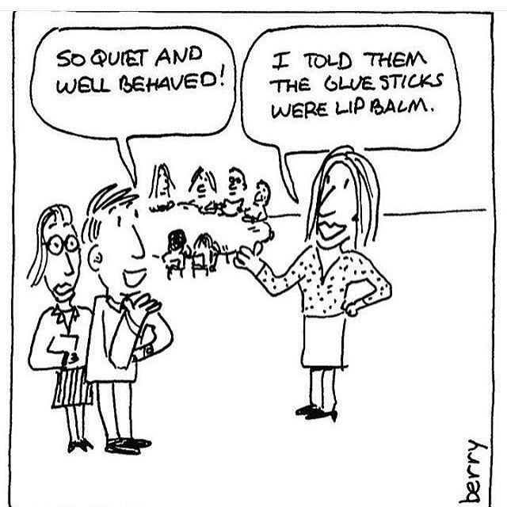
Integration
Do
Use humor to enhance joy
Use humor to create community
Use content-related humor
Use age-appropriate humor
"Sandwich" humor between instruction and repetition
Avoid
Sarcasm
Cruel or inappropriate humor
Forced humor
Off-topic humor
Too much humor
https://www.edutopia.org/blog/laughter-learning-humor-boosts-retention-sarah-henderson

Slide 14
Example: Reading/Listening
Storytelling is a great way to build vocabulary, model elaboration and bring humor into the classroom.
Possible Activity:
Have students pair up and write what happened so that they can “deliver” the events in less than 1 minute. Must include at least 5 factual events from the story.
Read various 1 minute “stories” and determine how funny they are.
Reverse the process. Take a simple event and elaborate on it using benign violation theory to expand the event.

Slide 15
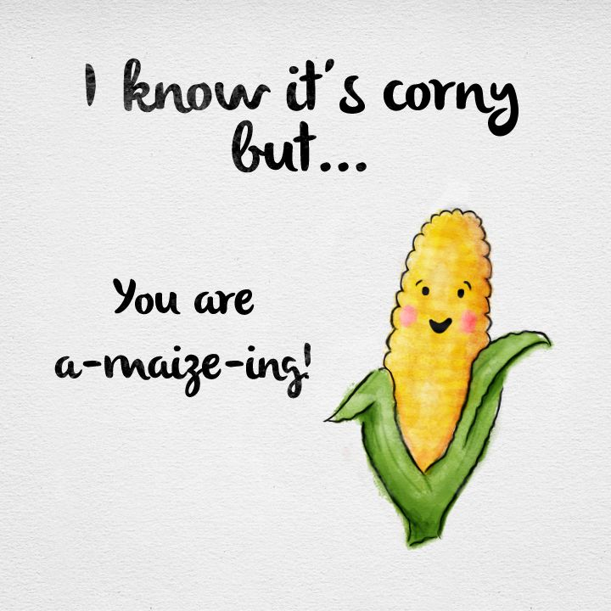
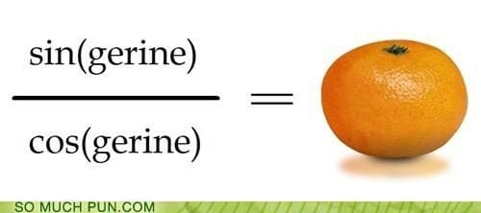
Example: Language Arts

Slide 16
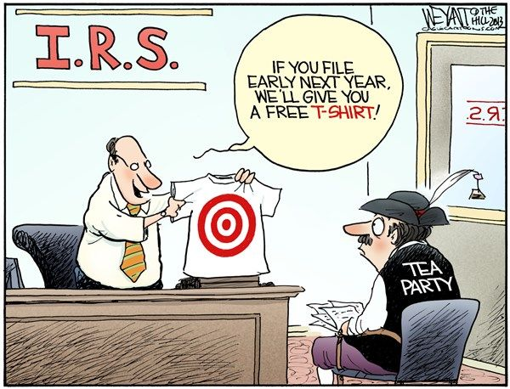
Example: Social Studies
Focus on the analysis of benign violation and understanding why some would or would not find these funny. Create understanding first, then approach the content.

Slide 17
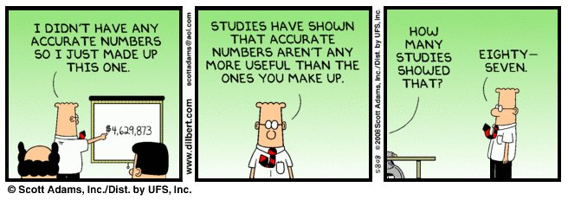
Example: Statistics

Slide 18
Spark of Humanity
Laughter is a critical “spark of humanity”. It resides within us to help us cope with the incongruity in our lives and world.
For adult education students it is a critical way to overcome the trials that they face.
As educators, we can use laughter appropriately to create a learning environment that draws our students in, gives them freedom of self-expression, opens minds, and increases critical thinking skills.

Slide 19
Key Sources and Homework
Article – Laughter and Learning: Humor Boosts Retention
Edutopia – March 31, 2015, Sarah Henderson
YouTube – Jeanne Robertson – “Men Don’t Know the Style in NYC”, “Don’t Send a Man to the Grocery Store”
YouTube – Peter McGraw – “What Makes Things Funny” – TedTalk
YouTube – Trevor Strong – “Humor and Education” – TedTalk
YouTube – Andrew Tarvin – “Humor at Work” – TedTalk

Slide 20
Summary
Laughter is key to creating community, friendships and learning
Humor can be explained through the “Benign Violation Theory”
The “Line” is mobile and requires an understanding of both the giver/receiver
Content-related humor is a great way to improve retention
Storytelling is a perfect medium for crafting humor
Integrating humor can be planned into your lessons

